Slide 1
Disaster triage
Sorting through the confusion
Sharon Medcalf, Ph.D.
UNMC College of Public Health
Notes:
Twofold purpose:
Acquaint with disaster triage
Consider ethical issues attendant upon mass casualty / public health crises

Slide 2
Objectives
Explain how and why ethical and medical priorities in a public health crisis (mass casualty or pandemic) differ from those in typical medical care.
Describe the five triage designations used in the mass casualty exercise in class.
Describe generally the steps to be taken by first responders in a mass casualty.

Slide 3
Objectives
Acknowledge the appropriateness, in a crisis, of directing limited resources to those who are unlikely to survive without intervention and likely to survive with intervention.
Acknowledge the moral duty of the provider to assist in a public health crisis even in the face of personal risk.

Slide 4
Notes:
[Provide a link for those who review after class?]
This reporter was among the first to arrive on the scene following the Joplin, Missouri tornado.
What would you do?
Where would you start?

Slide 5
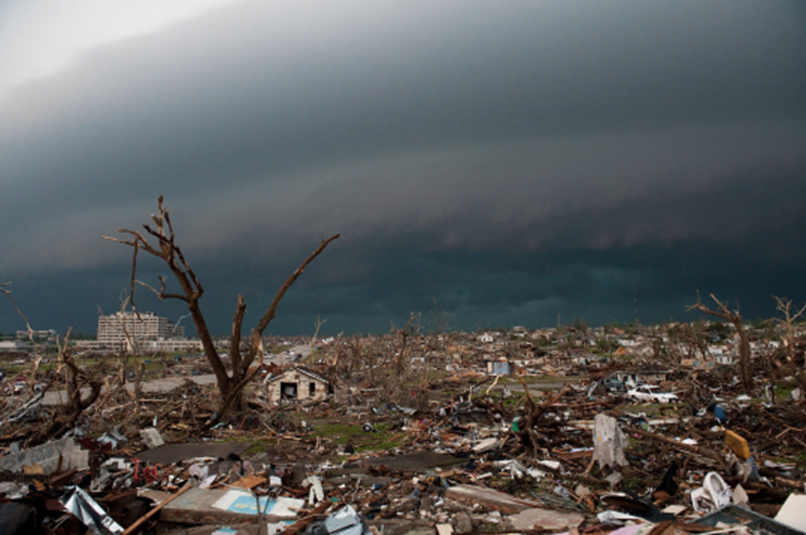
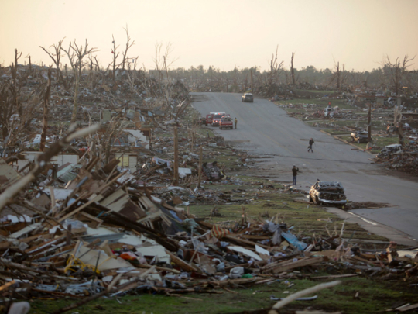
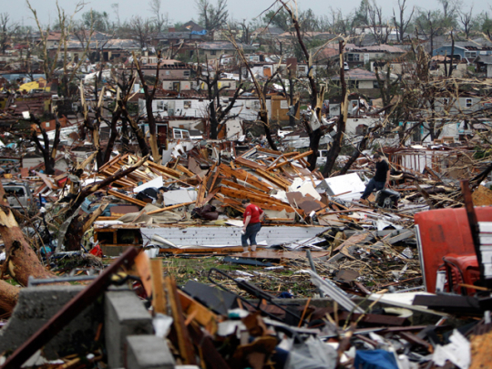
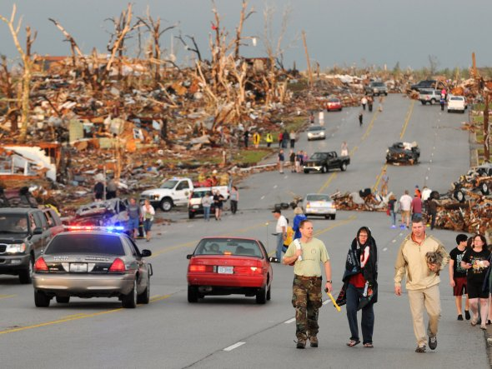
Notes:
Recent shots of tornado devastation.

Slide 6
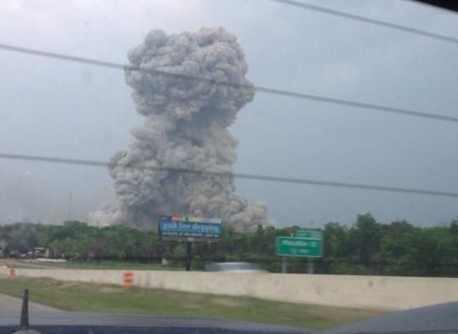
Notes:
Most towns have industries subject to catastrophic events. Some are self-contained (such as the grain bin explosion in Omaha, 2014); others have widespread impact. This is an image of the 2013 fertilizer plant explosion in West, TX, a small town near Waco. Consider not only the direct effect of the explosion, but the potential for toxic emissions in such events.
Wikipedia:
On April 17, 2013, an ammonium nitrate explosion occurred at the West Fertilizer Company storage and distribution facility in West, Texas, eighteen miles (29 km) north of Waco while emergency services personnel were responding to a fire at the facility.^{[6]} Fifteen people were killed, more than 160 were injured, and more than 150 buildings were damaged or destroyed. Investigators have confirmed that ammonium nitrate was the material that exploded, but the cause of the initial fire is as yet unknown.
. . .
The state fire marshal department said that investigators interviewed "almost 300 people," and followed 160 leads in their initial investigation.
In May 2013, the Texas Department of Public Safety instructed the Texas Rangers and the McLennan Sheriff's Department to join the Texas Fire Marshall's Office and the U.S. Bureau of Alcohol, Tobacco, Firearms and Explosives, in the criminal investigation into the explosion.^{[55][56]}
Ultimately, investigators blamed stocks of ammonium nitrate fertilizer stored in a bin inside a seed and fertilizer building on the property for the explosion^{[57]} but failed to identify what started the actual fire that led to the explosion.
On April 22, 2014, the U.S. Chemical Safety and Hazard Investigation Board released the preliminary results of its investigation into the explosion. It blamed the disaster on company officials' failure to take basic steps regarding safe storage of the chemicals in its stockpile, as well as inadequate federal, state and local regulations regarding the handling of hazardous materials.[

Slide 7
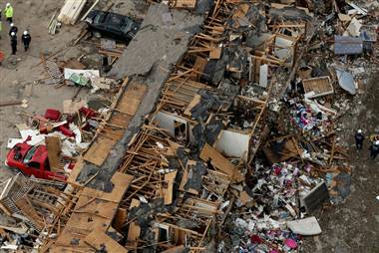
Notes:
A fifty-unit apartment building next to the West Fertilizer Company was destroyed. A middle school was severely damaged. A nursing home had to be evacuated. The fire leading to the explosion began at about 7 p.m. Most of the fatalities were among first responders.

Slide 8
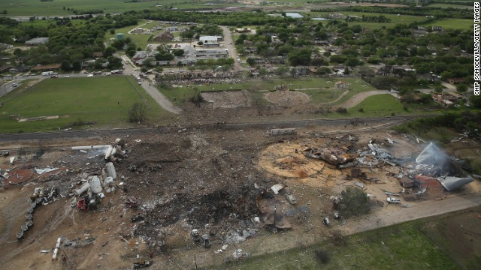
Notes:
Here is an aerial shot of the post-blast fertilizer plant site in West, TX.
Footage of explosion from three angles: https://www.youtube.com/watch?v=Ba8jTkRWiwI

Slide 9
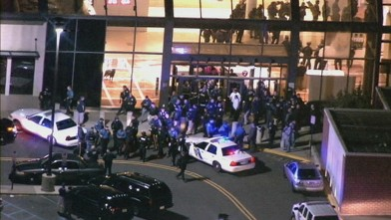
Notes:
Active shooter events appear to be on the rise.

Slide 10
Where & when is DISASTER triage needed?
Any time an event overwhelms local resources
Can be anywhere – even at your door!

Slide 11
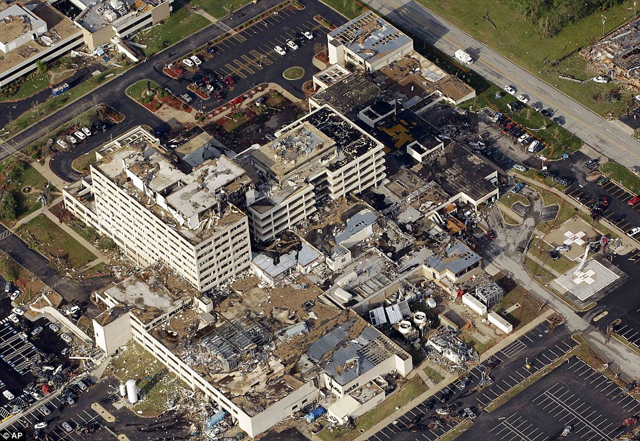
Notes:
St John’s Regional Medical Center in Joplin, MO was in the path of the tornado in 2011.
Wikipedia:
The 2011 Joplin tornado was a catastrophic EF5 multiple-vortex tornado that struck Joplin, Missouri, late in the afternoon of Sunday, May 22, 2011. It was part of a larger late-May tornado outbreak and reached a maximum width of nearly 1 mile (1.6 km) during its path through the southern part of the city.^{[6]} It rapidly intensified and tracked eastward across the city, and then continued eastward across Interstate 44 into rural portions of Jasper County and Newton County.^{[7]} It was the third tornado to strike Joplin since May 1971.^{[8]}
Overall, the tornado killed 158 people (with an additional four indirect deaths), injured some 1,150 others, and caused damages amounting to a total of $2.8 billion. It was the deadliest tornado to strike the United States since the 1947 Glazier-Higgins-Woodward tornadoes, and the seventh-deadliest overall. It also ranks as the costliest single tornado in U.S. history.
. . .
Immediately following the disaster, emergency responders were deployed within and to the city to undertake search and rescue efforts. Governor Jay Nixon declared a state of emergency for the Joplin area shortly after the tornado hit, and ordered Missouri National Guard troops to the city.^{[22]} By May 23, Missouri Task Force One (consisting of 85 personnel, four dogs, and heavy equipment) arrived and began searching for missing persons. Five heavy rescue teams were also sent to the city a day later. Within two days, numerous agencies arrived to assist residents in the recovery process. The National Guard deployed 191 personnel and placed 2,000 more on standby to be deployed if needed. In addition, the Missouri State Highway Patrol provided 180 troopers to assist the Joplin Police Department and other local agencies with law enforcement, rescue, and recovery efforts which also included the deployment of five ambulance strike teams, and a total of 25 ambulances in the affected area on May 24 as well as well over 75 Marines from the Ft. Leonard Wood Army Base.

Slide 12
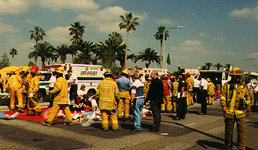
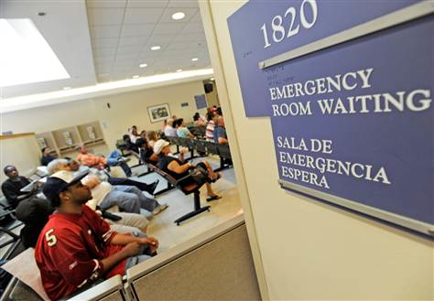
Differences between ED/Hospital triage and Mass Casualty triage

Slide 13
Hospital triage
Patients present to emergency department
Severity of injury or illness is assessed
Most severely ill or injured are cared for first
Notes:
Hospital triage assesses patients who present to the ED to determine the severity of their injury or illnesses. Those who are more seriously ill or injured will receive care before those less seriously ill or injured, regardless of likelihood of survival.
Based primarily on urgency, hospital triage assumes that eventually all patients will be treated in a manner appropriate to their conditions.

Slide 14
Mass casualty triage definition
The sorting of patients by the seriousness of their condition and the likelihood of their survival
The greatest good for the greatest number possible
Dependent on resources available
Notes:
Disaster triage assumes that resources are limited, and that judgments must be made in the distribution of resources. Victims are quickly assessed for severity of injury, but those who are the most seriously injured may be passed over for treatment (tagged as expectant) because of the amount of resources those patients could take up.
In a mass casualty event, all patients cannot be treated simultaneously. Dedication of resources to people unlikely to survive could result in excess deaths among those who could have survived had they been treated more quickly.
The first step in the process is to sort groups of patients. The next step is to assess and sort individual victims.
The need for triage depends largely on the available resources. When resources exceed need, there is no need for triage. In the event of a disaster or mass casualty incident, however, the opposite situation applies. Health care needs EXCEED resources in these scenarios.

Slide 15
Triage
Multiple triage systems in use
Various methods using tags, categories, colors, symbols
Be familiar with your agency’s system and PRACTICE it
IDEAL = one uniform system used by all agencies in the field & at hospitals
Notes:
Triage (from the French trier [pronounced tree-ay]) is the sorting of patients by the seriousness of their condition and the likelihood of their survival.
Several different triage systems are in use, derived from both military and civilian sources. They employ different methods of classifying and tagging victims using symbols, colors, and other devices. Healthcare workers, first responders and EMS personnel among you might want to take the time to familiarize yourself with the system used by your agency. Ideally, everyone – both field personnel and hospital personnel – would use the same system. This would minimize confusion and maximize communication.

Slide 16
Step 1: Global Sorting
Notes:
The Global Sorting is designed to divert the uninjured and less injured from the scene so that you can assess the most severely injured.

Slide 17
Step 2: Individual Assessment
Notes:
Among the people who DO NOT MOVE OR RESPOND, you must make rapid judgments about their likelihood of survival and the urgency of their condition.
A quick summary (to be covered in greater detail in later slides):
As you assess each person, check Airway, Breathing, Circulation as in the cross at the upper left.
If no breathing after quick intervention, tag the person as black (dead) and move on.
If the person is breathing, responsive, not bleeding out, has peripheral pulses, then the person is either green or yellow – at the present time. This person either “has to wait” (yellow) or “can wait” (green).
If any of those features is absent (e.g., no peripheral pulse in extremities (circulatory failure or crushing, uncontrolled hemorrhage, respiratory distress, unconsciousness), then you must decide whether priority care is likely to save the person’s life (red;“can’t wait”), or whether the person is likely to die even if priority care is given (gray; expectant).
When this group has been assessed, tagged, and counted, and the appropriate level of care begun if possible, go back and assess the yellows, then the greens, being mindful of potential changes of status.

Slide 18
Minimal (green)
Alert, Oriented
Minor injuries
Abrasions, Contusions & Lacerations
Can be gathered and treated, then released
Notes:
The Green group consists of the uninjured or minimally injured patients who require the least critical care. These patients are awake and ambulatory (and would have a normal score of 6 on the motor portion of the GCS or Glasgow Coma Score, noted below.)
These people are identified by announcing, “everyone who can hear me, please move to the area with the green flag.”
Eye opening (E)
4 = spontaneous
3 = to voice
2 = to pain
1 = none
Verbal response (V)
5 = normal conversation
4 = disoriented conversation
3 = words, but not coherent
2 = no words, only sounds
1 = none
Motor response (M)
6 = normal
5 = localizes to pain
4 = withdraws to pain
3 = decorticate posture
2 = decerebrate posture
1 = none
Total Glasgow Score = E+V+M
Note that the phrase 'GCS of 11' is essentially meaningless, and it is important to break the figure down into its components, such as E3V3M5 = GCS 11.
A Coma Score of 13 or higher correlates with a mild brain injury, 9 to 12 is a moderate injury and 8 or less a severe brain injury.

Slide 19
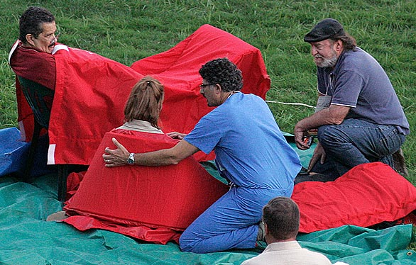
Notes:
At the outset, the following presumptions are made about this group:
Airway, breathing, and circulation are intact.
Mental status is intact, at least to the extent that they can follow commands.
These patients are NOT likely to have low blood pressure or breathing trouble.
As such, this group should undergo formal assessment LAST, after that of the more critically injured victims.
Why invest time to identify this group early?
Active management of this group will conserve scene resources for those victims with the most dire need.
And it may reduce self-transports and unnecessary overburdening of hospital emergency departments by minimally injured persons.
Hence, limited hospital resources can be saved for the more critically ill, as well.
Limitations: not based upon individual assessment yet.
Some conditions may worsen over time, necessitating triage to a more urgent category.
Ideally, trained personnel should monitor and frequently reassess these patients, re-triaging as needed.
This gets them out of the way so that you may find the higher priority patients.
This also puts them in one area so they may be contained and assessed there when enough personnel become available.
ideally, assign someone to keep them in that area or else they will wander off.
These patients must be assessed and reassessed as soon as possible as patients may deteriorate and change from their initial triage categories.
- Uninjured people in this category may be put to work tending to other victims.

Slide 20
Delayed (yellow)
Will need definitive care
May be unable to walk
Able to follow simple commands
However . . . beware of hidden injuries
Notes:
The next group to be identified is the DELAYED group. These victims may not be able to walk, but are awake and able to follow commands to call out or to move an arm or a leg.
They are identified by asking, “everyone who can hear me please raise an arm or a leg so that we can come help you.”

Slide 21
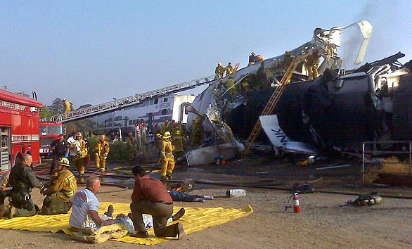
Notes:
Airway, breathing and circulation and mental status in this group are at least adequate enough to allow the victims to follow simple commands.
Since they are not ambulatory, they may have low blood pressure, low blood oxygen levels and/or significant injuries.
They will be individually assessed as the second group, after the IMMEDIATE victims.
The same caveats apply for this group as for the greens: they are sorted initially as a group, without individual assessment and some may deteriorate to become more urgent treatment priorities. Hence, individual assessment MUST BE PERFORMED as soon as possible to identify and treat immediate life threats that may be present.

Slide 22
Immediate (red)
Does not move –
Quiet = not good!
Needs surgical or life saving interventions
May die without intervention
Notes:
Now that all the patients who can MOVE have been identified, the next focus is on INDIVIDUAL ASSESSMENT of those victims who are left. Since they cannot either ambulate or follow simple commands to move (lower score on the motor scale of the GCS), it is assumed that they are more critically injured. Rescuers must proceed immediately to these patients to deliver critical life-saving interventions. This group of victims is now the red, IMMEDIATE group.
Who are the IMMEDIATE patients? These are the sickest victims who might yet survive if life-threatening injuries can be addressed. First and foremost are the ABCs of Airway, Breathing and Circulation, as well as mental status and level of consciousness. These victims also likely have low blood pressure, low blood oxygen levels and/or life-threatening injuries. Some of these patients will be later classified into EXPECTANT group upon individual assessment. Others may be restaged into less emergent groups when they are found to have other, less critical reasons for their lack of movement. These might include acute hearing loss as the result of explosions, chronic hearing impairment, or chronic disabilities. As with the DELAYED group, only with individual assessment will their true status become known.
As a whole, this is the group of patients most likely needing immediate assistance . . . they are also likely to be the quietest group (the people yelling for help the loudest are NOT the ones who probably need help the most; thus, it may take some amount of willpower to bypass the louder patients on the way to the unresponsive ones)

Slide 23
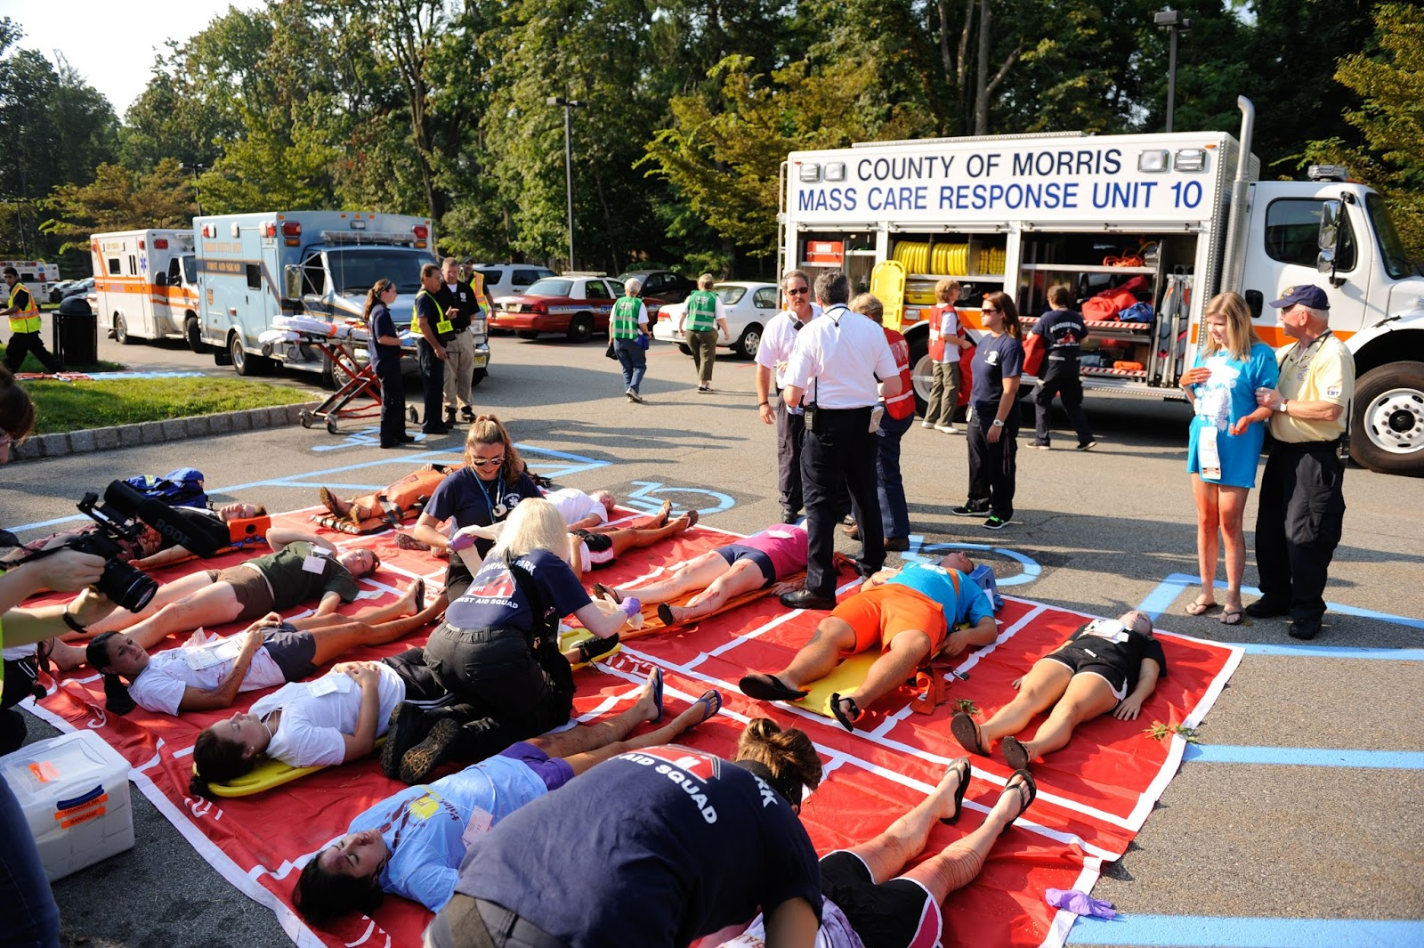
Notes:
Go to these patients first and deliver immediate life-saving interventions (bleeding control, airway opening, perhaps a MARK 1 kit), but that’s it for this moment.
Whatever category the patient is in, tag him as such and move quickly to the next IMMEDIATE (failure to tag patient will result in another rescuer having to spend time triaging the same patient).
Don’t forget that some of these patients may belong in other triage groups despite their initial grouping as immediate.
For example, some may be dead or expectant.
Expectant patients are those with likely fatal injuries.
Dead patients should be tagged as such to prevent consumption of resources or wasting time by having other personnel attempting to triage the patient again.

Slide 24
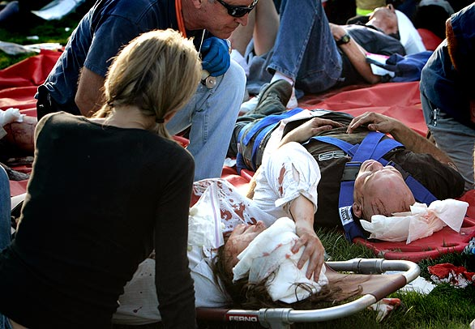
Notes:
The next step in the sequence is the individual ASSESSMENT of IMMEDIATE patients.
The goal is to obtain an accurate count of these most severely injured patients who still have a chance of survival if proper treatment can be delivered quickly. (Similarly, victims who are either EXPECTANT or DEAD will also be identified during this stage.)
(The I.C. or Transport Officer should contact hospitals to advise them of the number of patients on-scene and to ask how many IMMEDIATE patients each hospital can accept . . . he must then ensure that the patients are distributed to the different hospitals in a logical manner and order)
ABCs are assessed VERY rapidly.
Is a likely fatal injury present – such as a massive open brain injury? If yes, the patient is assigned to the EXPECTANT group and the rescuer proceeds to the next patient.
If the patient does NOT meet criteria for triage to expectant or dead categories, a LIMITED number of immediate life threats can be managed, but only in a most basic way at this time.
Relatives or other uninjured people may be allowed to stay with more seriously injured people so long as they don’t impede care.

Slide 25
Expectant
(gray, blue, purple)
Severely injured
Likely to die regardless of interventions
Not enough resources to divert time / equipment from others
NOT A DEATH SENTENCE!
Notes:
Who is left? By this point, ideally, only EXPECTANT and DEAD victims will remain.
Ideally, the expectant victims will be physically grouped together into an EXPECTANT area, marked with BLUE signs/flags/tarps/etc. . . . As with the other groups, a team of rescuers should monitor and treat them until they are transported, if possible.
If their condition changes, their triage category can be changed at any time and they can be moved to the other category’s physical collection area.
As more resources become available and the IMMEDIATEs have been dealt with, more resources can be devoted to this group. Until then, one must recall that death might be hours or days away. Hence, any measure of comfort care possible should be provided. These patients should not be abandoned.

Slide 26
Dead (black)
Do not move!!!
Treat with dignity
Collect and preserve evidence, proof of identity
Notes:
The highest level medical director should personally re-assess all black-tagged patients and affirm their designation as DEAD.
Becky: Jump in on this one…..If final determination has been made that patient is dead and no resuscitation is to be attempted, DO NOT DISTURB THE REMAINS OR THEIR IMMEDIATE SURROUNDINGS.* Why?
evidence may be lost that could have led to:
proper identification of the remains
cause of death
time of death
crucial information about the incident
determination of whether this was an accident or an act of terrorism
The person or persons responsible for the attack/crime
PREVENTION of future attacks
* Exception -- small soft-tissue fragments may rapidly degrade if exposed to high temperatures (thus DNA may be denatured). If these are the only remains found, it may be advisable to obtain permission from law enforcement personnel to quickly move the tissue out of sunlight and into a cool area to preserve the DNA.
Law enforcement authorities will typically determine the disposition of deceased victim (whether the body will be released to the family or if an autopsy/investigation is to be performed by the medical examiner/coroner/etc.). This may vary according to state law.
Also: better not to strain on-scene resources caring for fatalities. Even for non-terrorism events, it is best to defer this care until additional specialized personnel and resources arrive, such as federal DMORT teams

Slide 27
Notes:
Disaster investigators examining site of derailment. Note covered body on left.

Slide 28
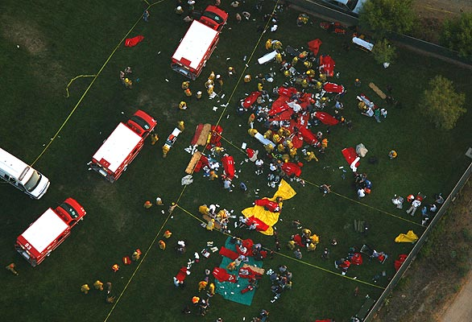
Notes:
Note systematic transport beginning with red zone.

Slide 29
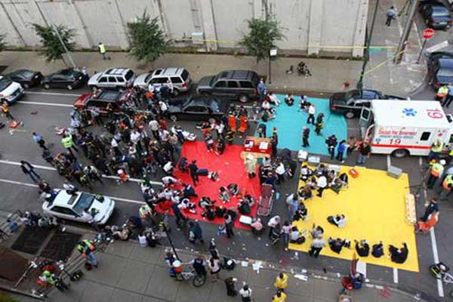
Notes:
Boston marathon bombing triage 2013.
Natalie Stavas, MD, a recent UNMC COM grad, was running in the marathon and leaped police barricades to reach the wounded. She was later interviewed by Anderson Cooper. Link below.
http://ac360.blogs.cnn.com/2013/04/16/doctor-the-worst-thing-ive-ever-seen/

Slide 30
Transport
Immediate
Delayed
Minimal

Slide 31
Keep in mind . . .
Challenges
Multiple responding/arriving agencies and personnel
Initial responders are overwhelmed
Notes:
Multiple responding personnel and agencies may diminish effectiveness.
Initial responders are tremendously overwhelmed and may not be able to provide direction and guidance to back up responders – thus adding to the chaos and unproductivity. There is a need for quick, job aids to help those recall information when they are stressed out.

Slide 32
Keep in mind . . .
Limited supplies
Scene hazards
Decontamination issues
Unfamiliar procedures
Notes:
Limited supplies.
Triage markers – what will we use? Do we know how to document and mark things off? Is the time to learn this when we are in the midst of a disaster or do we need to practice beforehand?
Scene hazards – is the scene safe? Are responders in danger?
Decontamination issues
Tasks need to be performed by individuals who may not have ever had to perform these tasks before.

Slide 33
Your turn…………

Slide 34
Adult male, breathing, moaning, obvious leg fracture. Follows commands.
Green
Yellow
Red
Grey
Black

Slide 35
Adult male, multiple shallow lacerations on the head, walking towards you, screaming that he needs immediate assistance. Follows commands.
Green
Yellow
Red
Grey
Black

Slide 36
Adult female, unconscious, breathing labored, large chest wound.
Green
Yellow
Red
Grey
Black

Slide 37
Adult female, open head wound. Grey matter visible. Respirations labored and irregular. No peripheral pulses palpable.
Green
Yellow
Red
Grey
Black

Slide 38
Let’s combine your knowledge and a time limit:

Slide 39
Extreme wind storm
Structure collapse at local retail chain store
Initial reports of ~ 200 injured
Possible fatalities
Trapped individuals
Notes:
You’re a resident of a small town which has experienced a weather disaster.

Slide 40
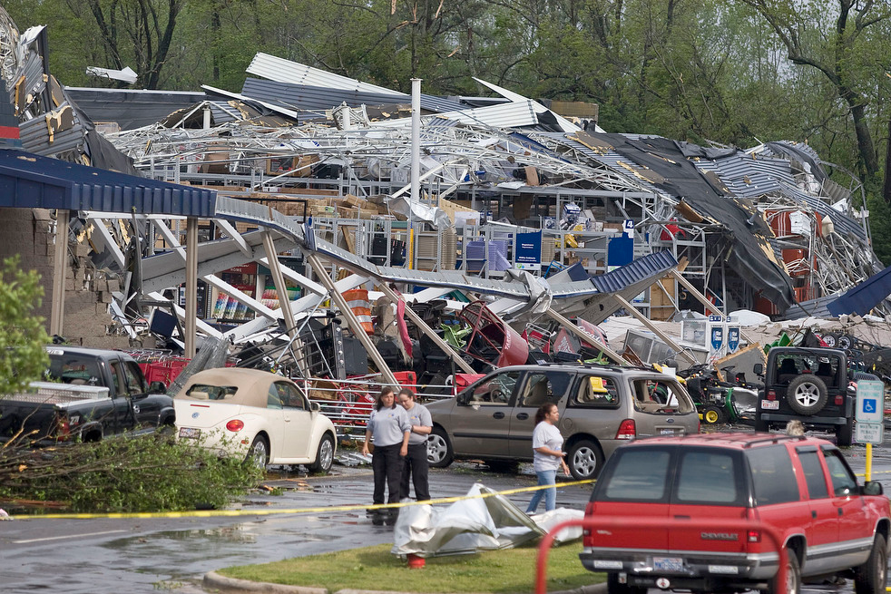

Slide 41
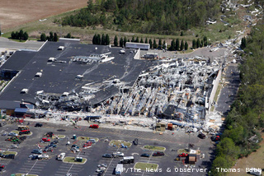

Slide 42
First . . .
What on-scene hazards might you expect?
What types of injuries will you expect?
Where will you set up triage?
What medical evacuation challenges will there be?
DO NOT spend more than 30 seconds per victim.
Notes:
Assignment: gather in small groups, and triage the individuals you encounter as you enter the site.
Descriptions are on the slips of paper.
You’ll be given ‘tarps’ of various colors on which to place the patients.
As you work, pay attention to issues on which you disagree or otherwise struggle to make a determination.

Slide 43
Your Turn Again

